Slide 1
BRISBANE’S INNER CITY STRATEGY
Our plan for a future alive with opportunity
Economic Development and the Brisbane 2032 Olympic and Paralympic Games Committee
9 May 2023
Legacy and Precinct Planning Manager
Brisbane 2032 Host City
City Planning and Sustainabilty

Slide 2
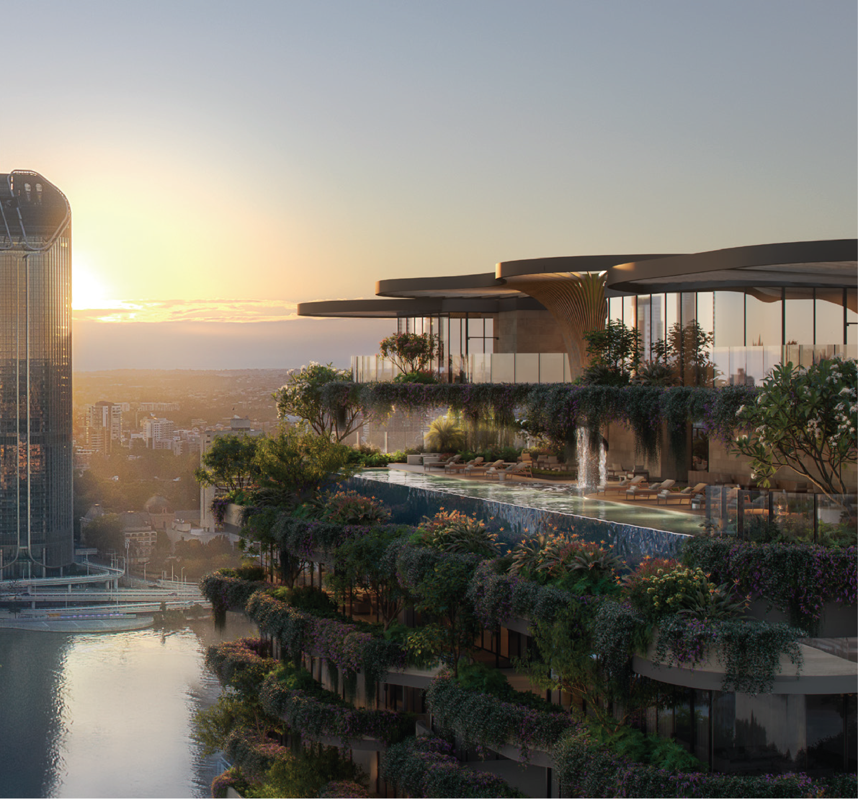
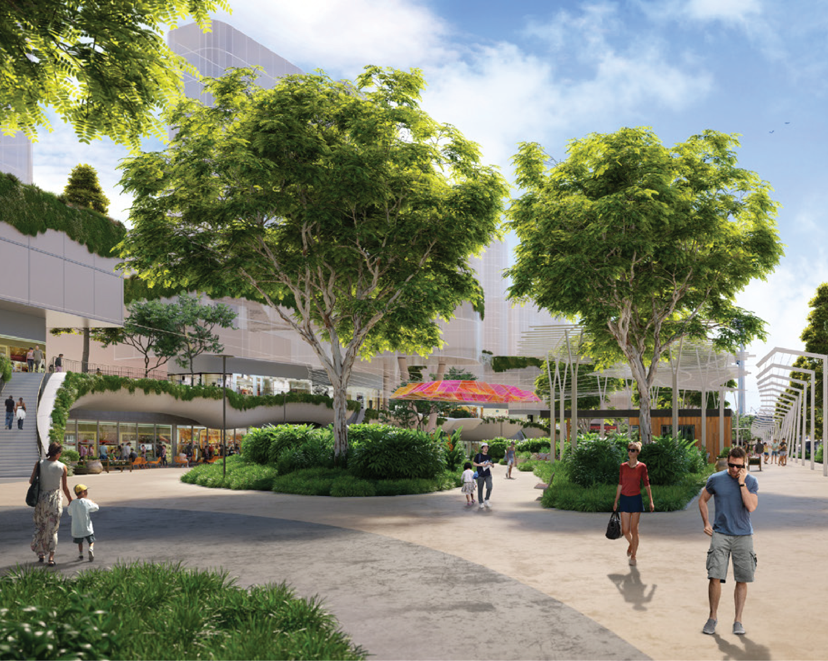
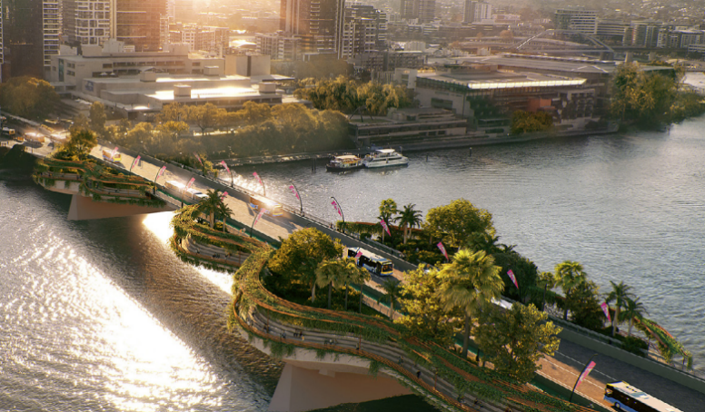
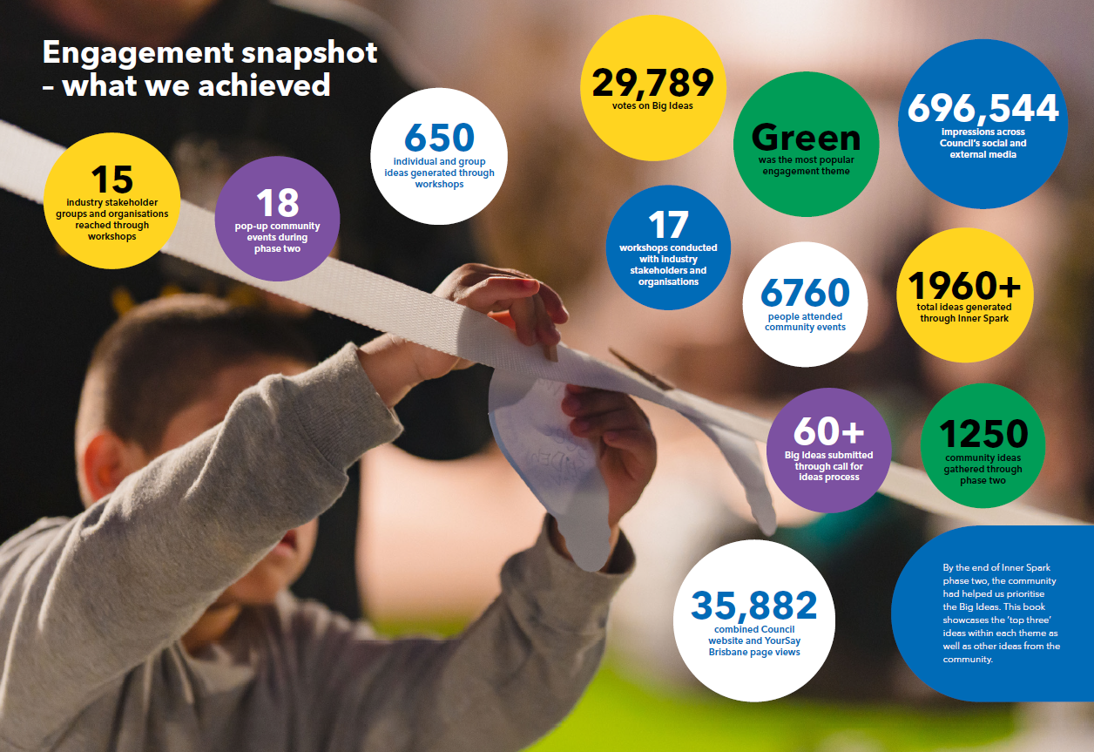

Inner Spark engagement
In 2022, Council launched Inner Spark – a citywide conversation and engagement program with the aim of generating the brightest ideas from the community to shape the future of the inner city
Feedback received through Inner Spark has been used to inform the Sustainable Growth Strategy and Inner City Strategy, and will continue to inform inner city precinct planning into the future

Slide 3
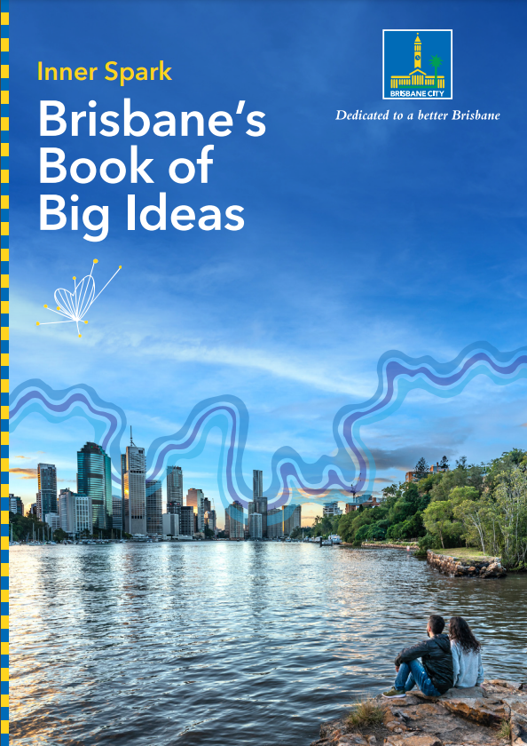
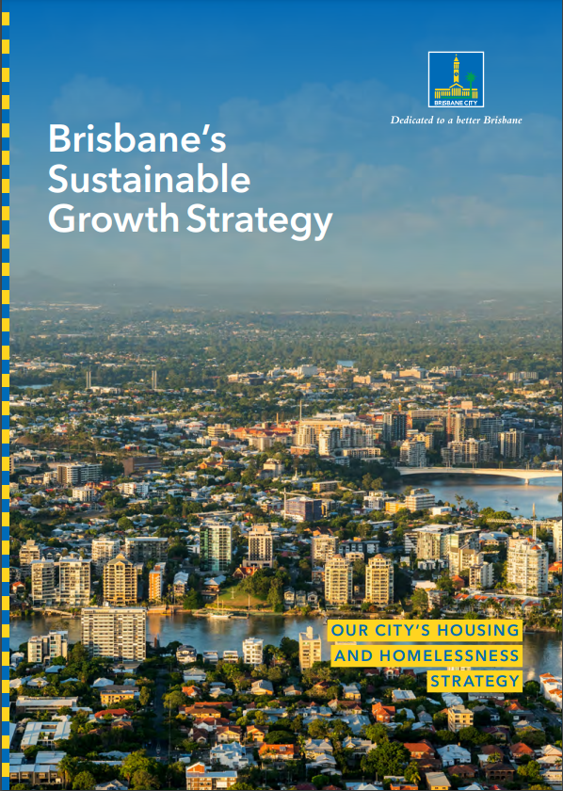
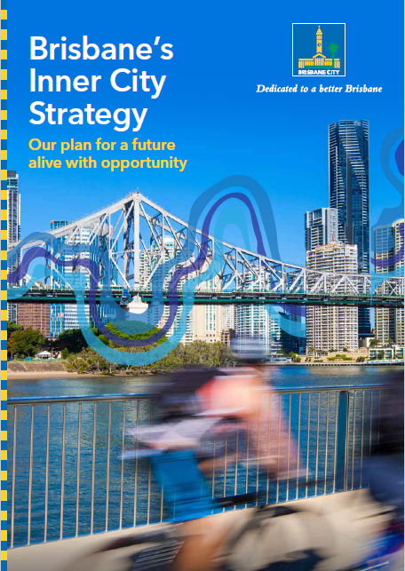

Slide 4




Brisbane’s Sustainable Growth Strategy
1
2
3
4
Sustainable, liveable and well-designed subtropical homes
Housing supply for our growing and evolving city
Housing diversity and affordability
Right housing in the right locations
Deliver suburban renewal, inner city precincts and Urban Enterprise Areas to facilitate housing supply and jobs for the city.
Create new housing options for all residents at every stage of life.
Create sustainable, liveable suburban and inner city precincts close to jobs, community services, recreation and transport.
Embed subtropical design principles into City Plan to ensure new residential buildings are appropriately designed to suit our climate and lifestyle.

Slide 5
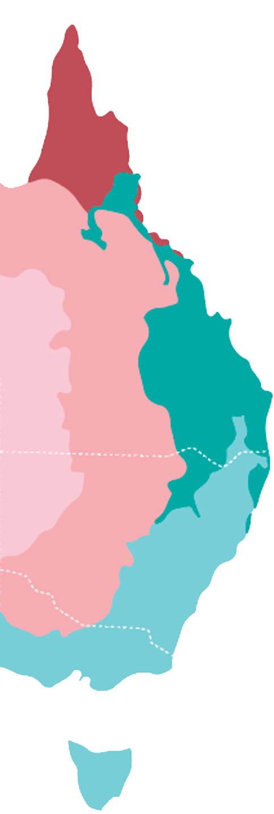


<?xml version="1.0" encoding="UTF-8"?><svg xmlns="http://www.w3.org/2000/svg" viewBox="0 0 213.05 275.28"/>
Brisbane’s Inner City
473,000
residents by 2041
Brisbane is a gateway to the Asia Pacific region and is defined by its enviable lifestyle and growing knowledge economy
Inner Brisbane accounts for approximately 6% of the LGA by area but produces almost 50% of the GRP and more than 40% of employment
570,000
workers by 2041
60%
Knowledge-intense employment

Slide 6
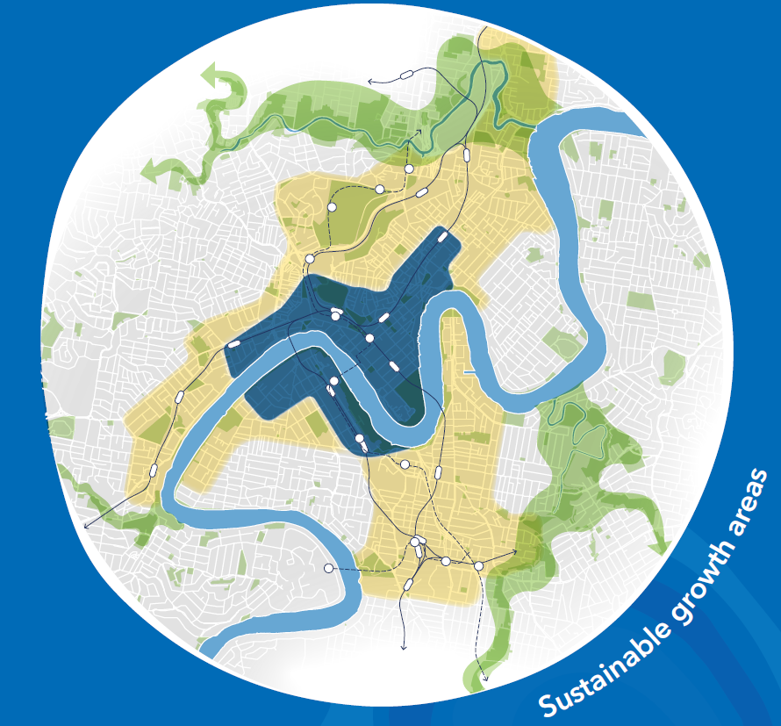
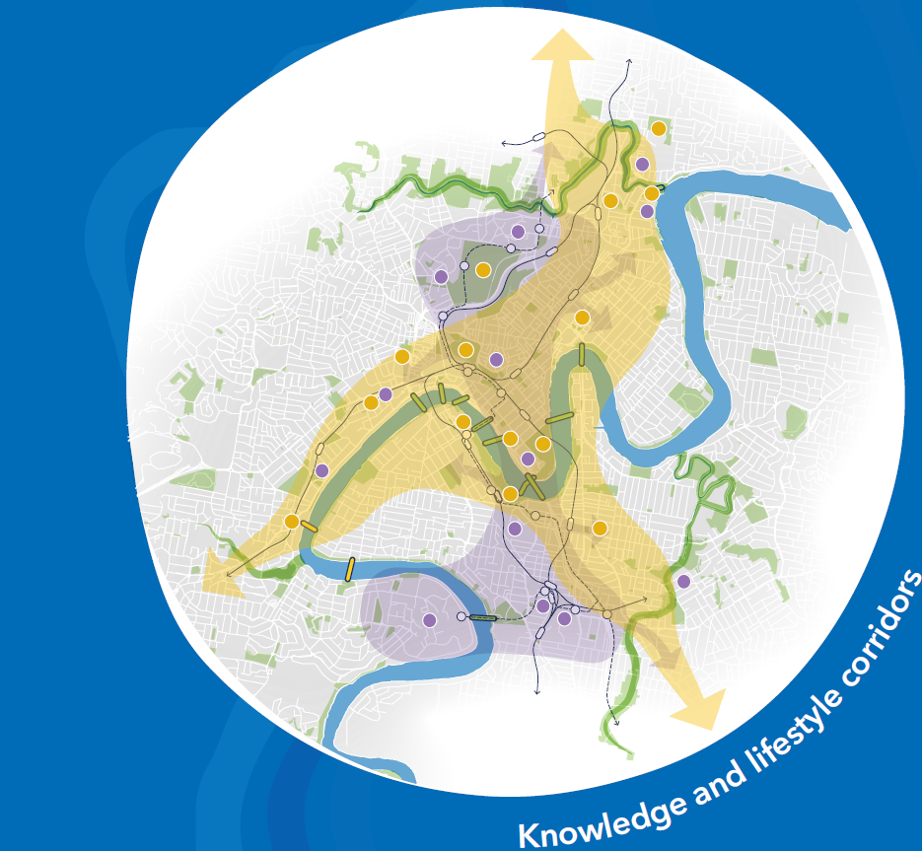
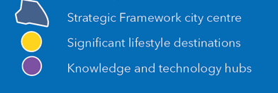

Slide 7
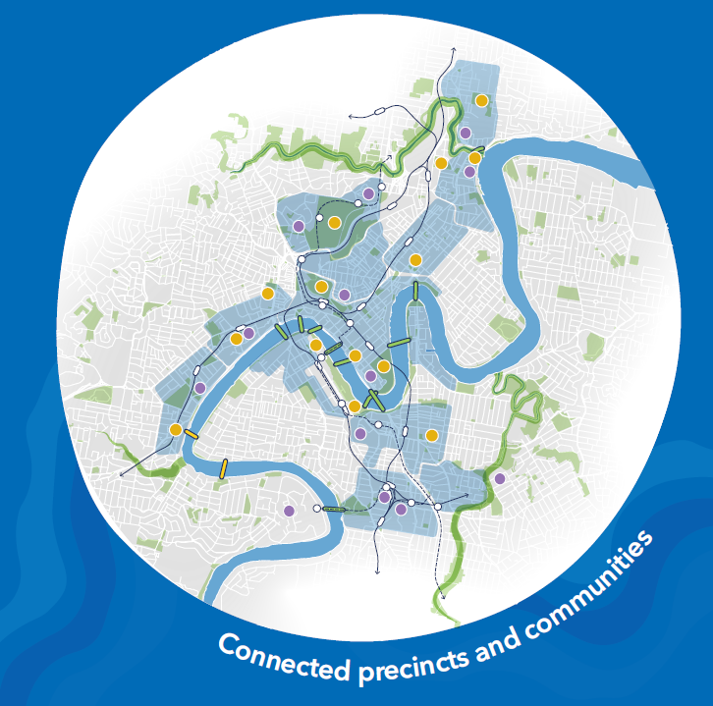
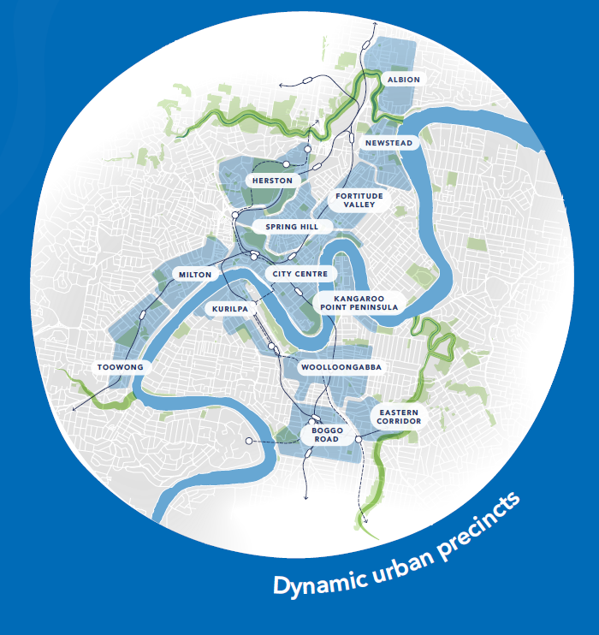
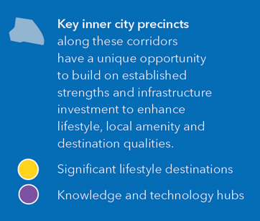


Slide 8
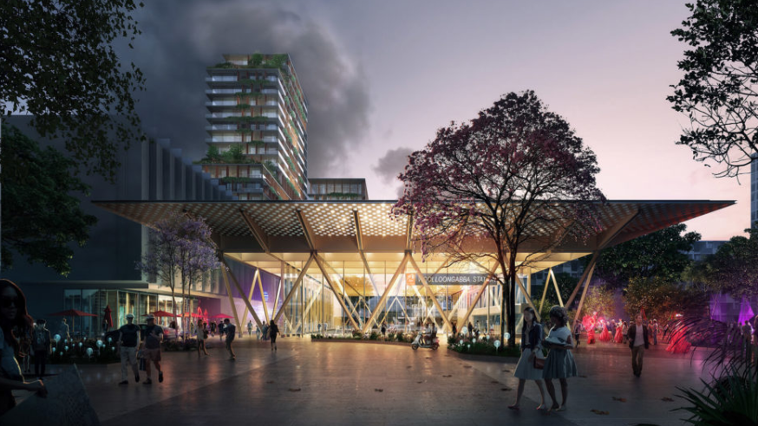
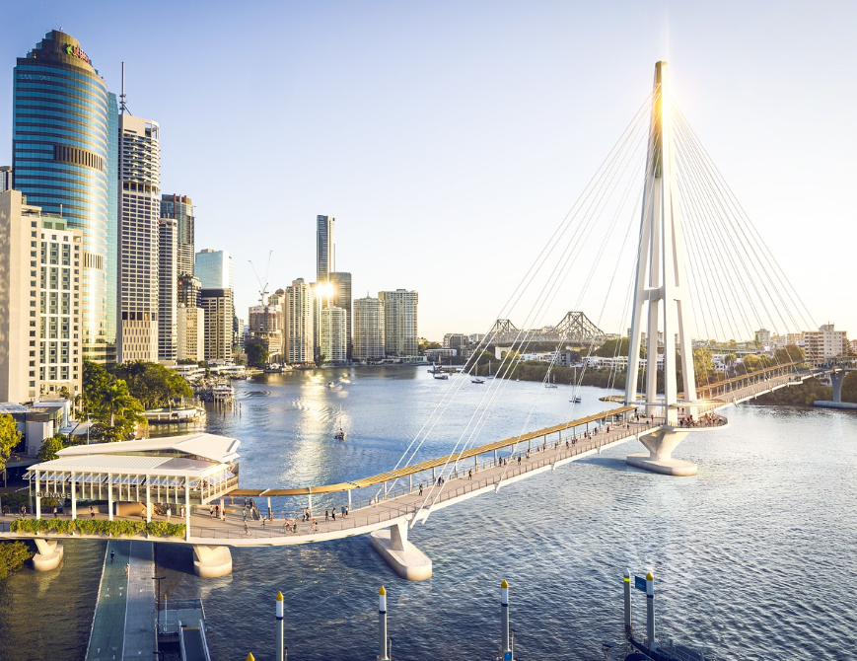
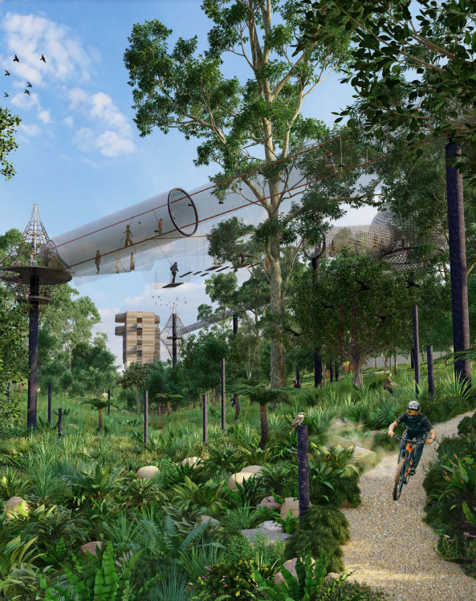
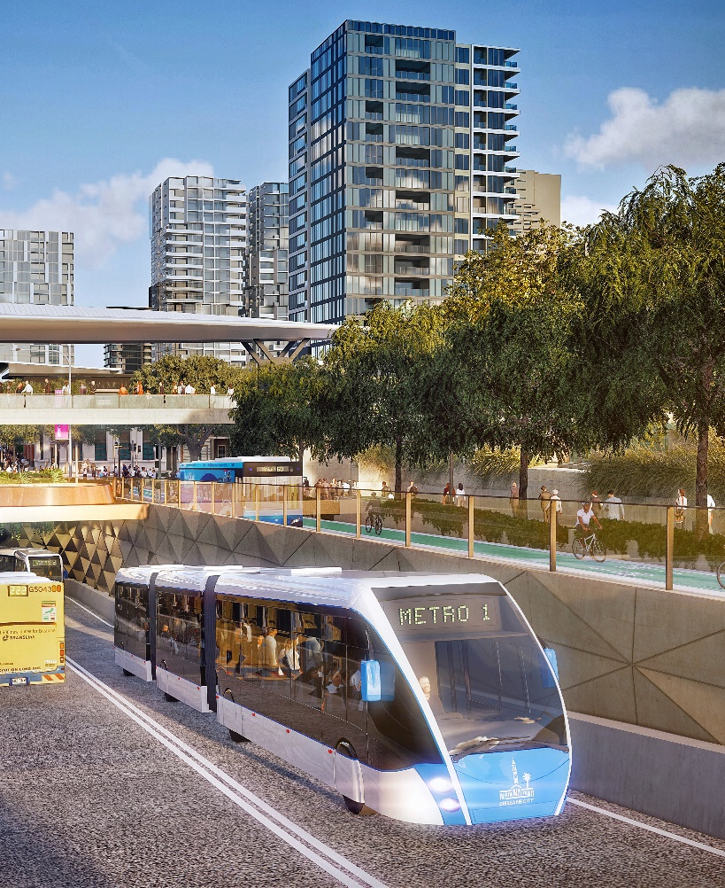

Changing inner city
Brisbane named Host City for the Brisbane 2032 Olympic and Paralympic Games
Council released Brisbane’s Sustainable Growth Strategy
Private sector development and investment attraction
New Infrastructure and community facilities being delivered:
  Brisbane Metro
  Cross River Rail
  Kangaroo Point green bridge
  Neville Bonner bridge
  Victoria Park / Barrambin Master Plan
  Expansion of South Bank Parklands
  A new 1,500-capacity theatre at QPAC
Cross River Rail
Green bridges
Victoria Park / Barrambin
Brisbane Metro

Slide 9
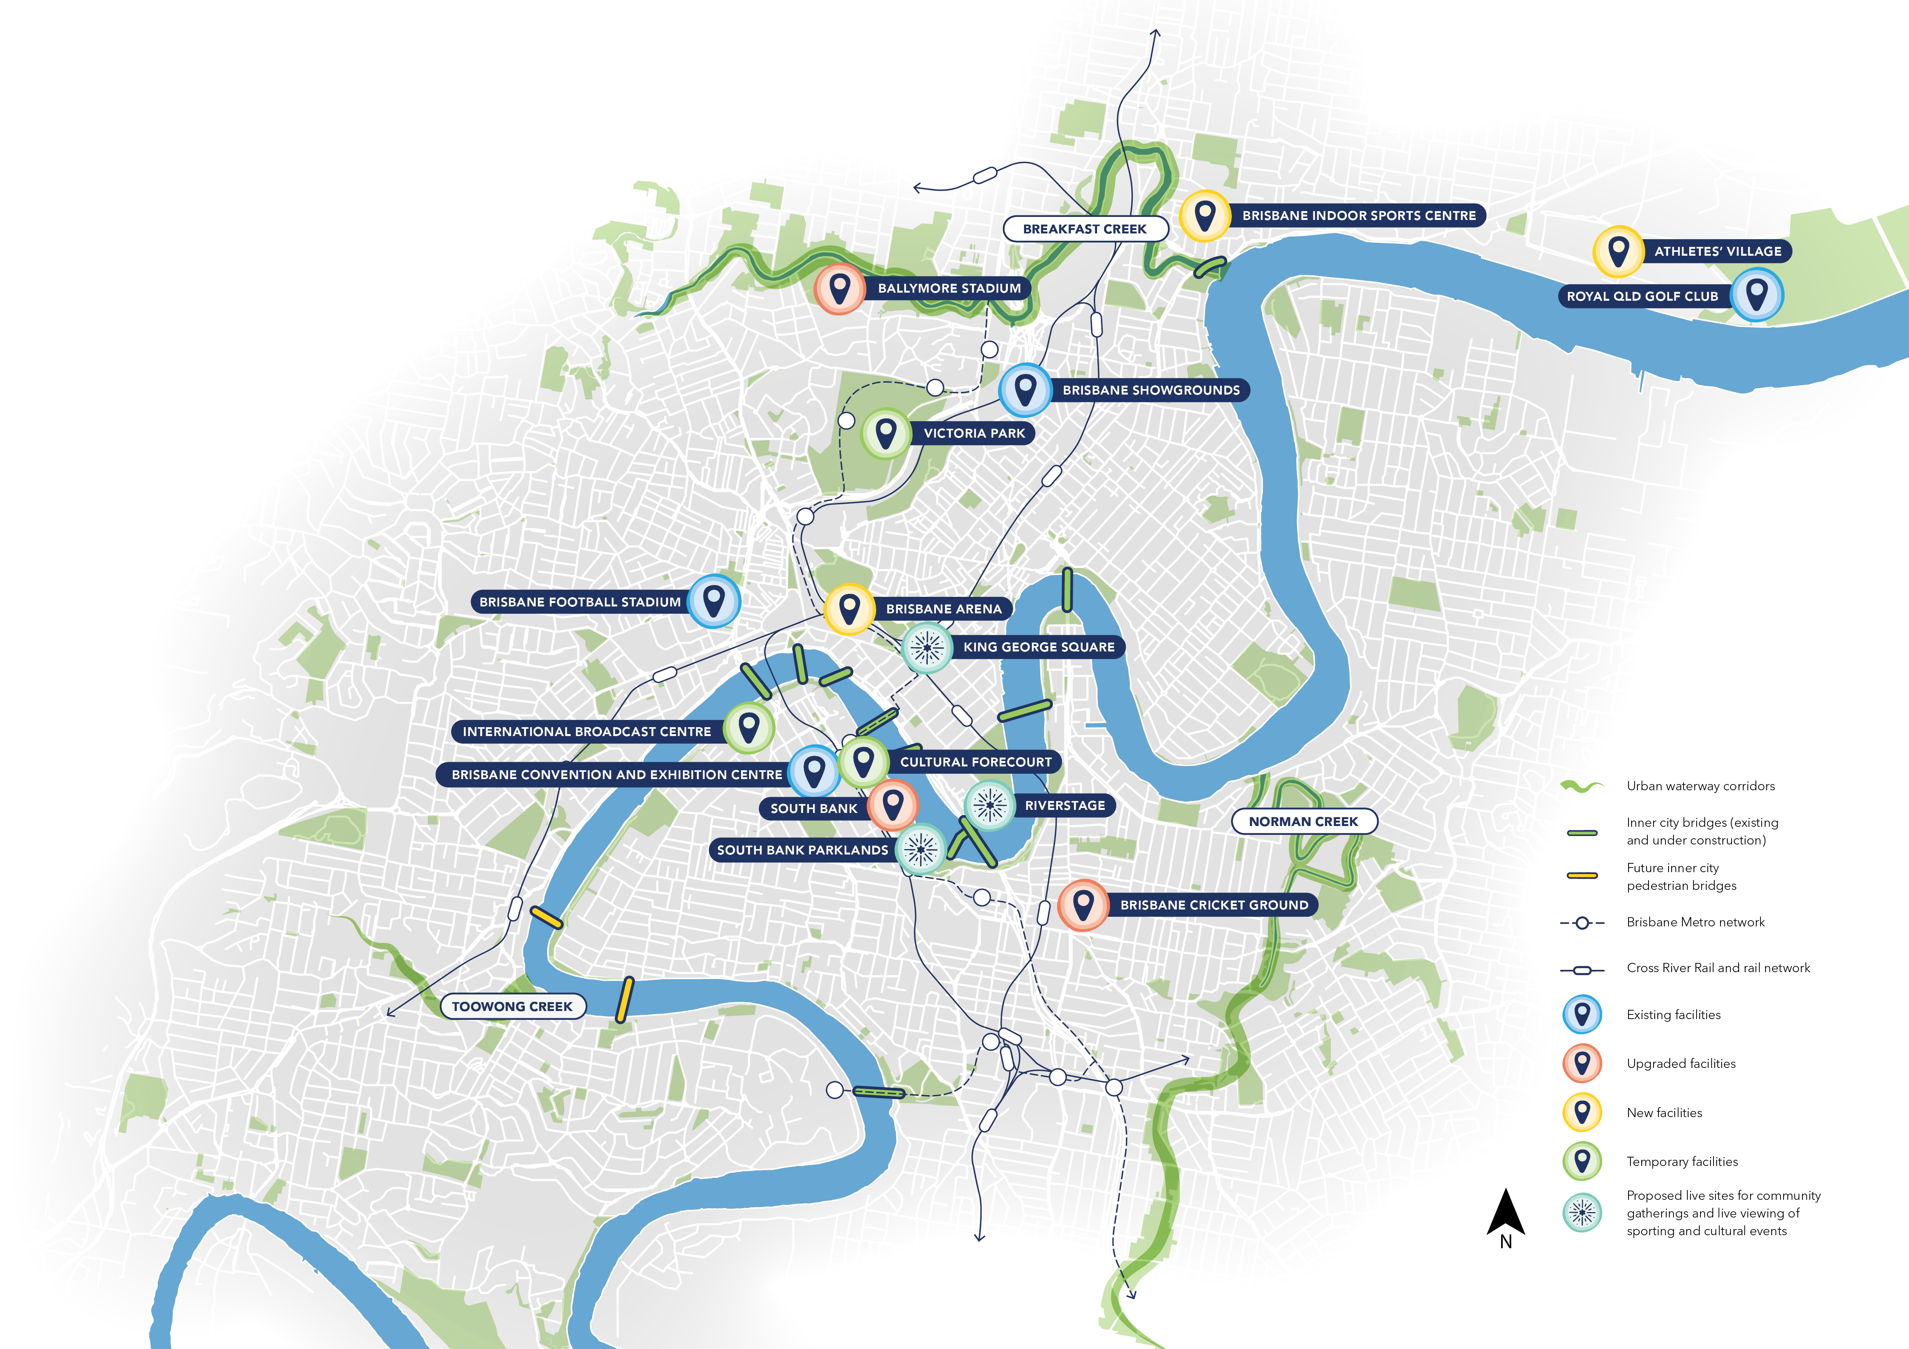
Brisbane 2032
Games Venues
Brisbane’s inner city is at the heart​ of the action
​
The Games present a unique opportunity to catalyse investment in local venues, infrastructure, places and communities
The focus will be on upgrading and optimising our infrastructure, as well as connecting our venue precincts

Slide 10
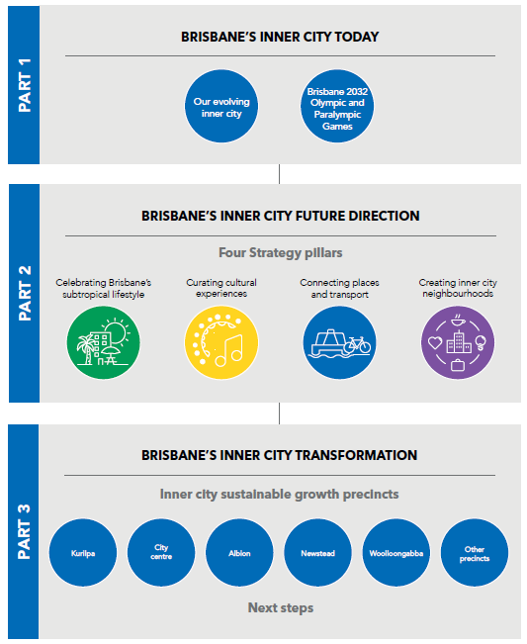
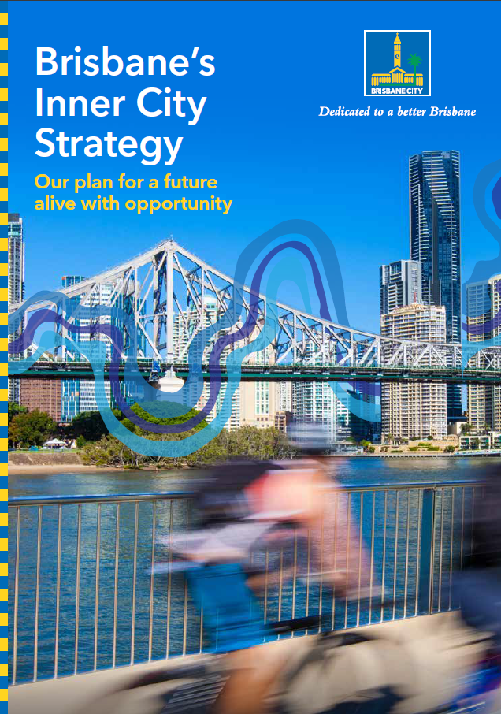
PART 1 outlines the vital importance of Brisbane’s inner city
PART 2 sets the strategic direction that will help shape the future of Brisbane’s inner city, underpinned by four key pillars.
PART 3 is a call to action, highlighting the need to prioritise precinct planning to drive transformative change.

Slide 11



Four Strategy pillars
Four Strategy pillars set the strategic direction for Council and provide guidance for the private sector and the community. Each pillar is supported by future directions that have been informed by the community and will help shape the future of Brisbane’s inner city.
Celebrating Brisbane’s subtropical lifestyle
Curating
cultural experiences
Connecting places and transport
Creating
inner city neighbourhoods

Slide 12
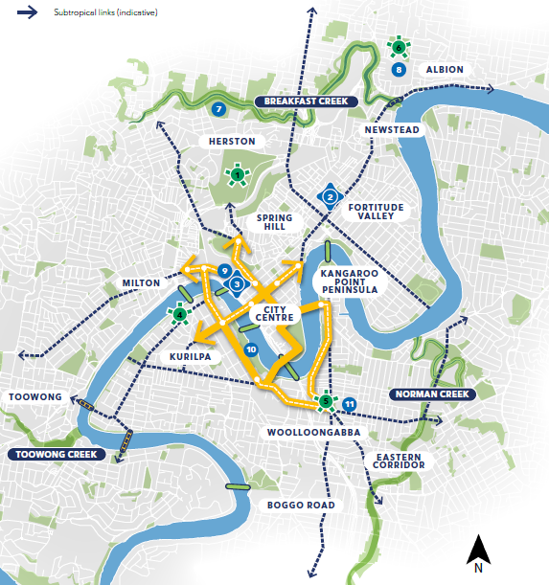

Future Directions
Deliver new open space to support growing inner city communities
Create a network of iconic boulevards to improve amenity, walkability and active transport links and connect our inner city and Brisbane 2032 Games venues
Deliver new public realm and green space in the inner city where people can relax, exercise, and enjoy our outdoor lifestyle
Facilitate more outdoor dining spaces to bring vibrancy to the city
Rewild and rehabilitate our inner city waterways
Develop Brisbane’s Design Rating Scheme to support best practice subtropical and environmental design
Plan for and support the delivery of new and enhanced inner city sports precincts

Slide 13
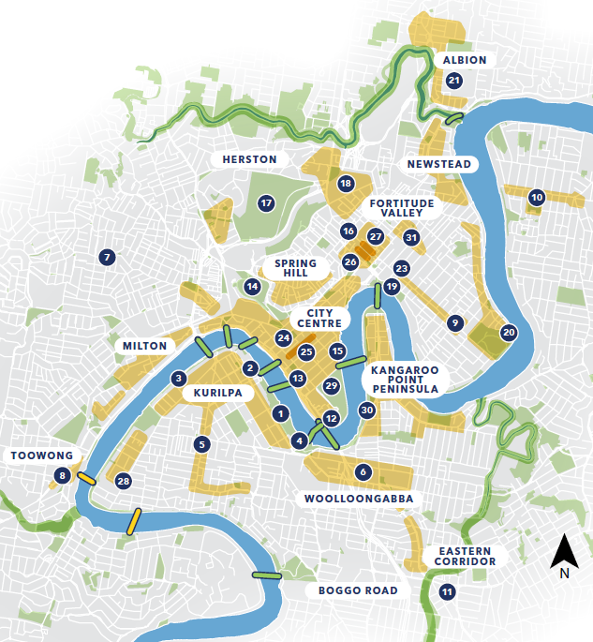
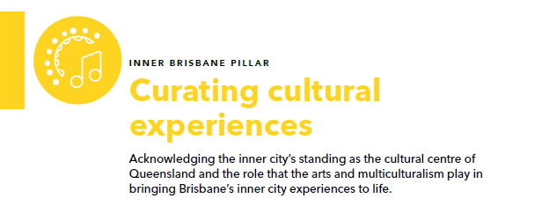
Future Directions
Address Council's Reconciliation Action Plan commitments
Deliver a world class program of art, culture, festivals and events
Leverage our Host City status to attract major sporting, cultural and business events to our inner city in the lead up to the Games
Progress, as part of SEQ City Deal, a new First Nations cultural facility within the inner city
Grow the 24-hour economy by enabling a greater mix of activities
Deliver more visitor experiences and promote Brisbane’s inner city as a destination of choice
Improve river based infrastructure and unlock new river tourism and recreational activities
Enhance digital assets to promote new experiences, events and cultural offerings

Slide 14
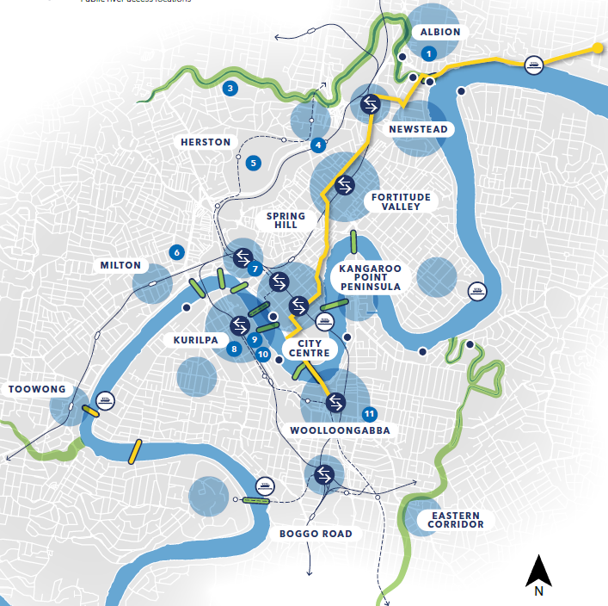
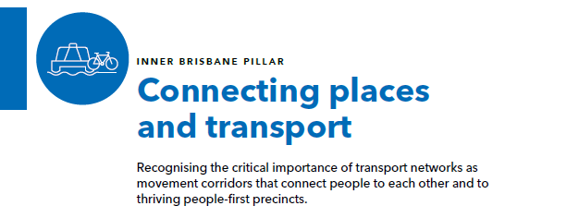
Future Directions
Create walkable and connected precincts across the inner city
Continue to deliver a network of green bridges and active travel links to better connect our inner city
Reduce car parking rates within inner city precincts that are rich in public and active transport infrastructure
Improve universal access outcomes to create an accessible and inclusive inner city with a focus on Games venues and precincts
Integrate the CityGlider rapid transit service into precinct plans
Support the emergence of interchange hubs at strategic locations

Slide 15
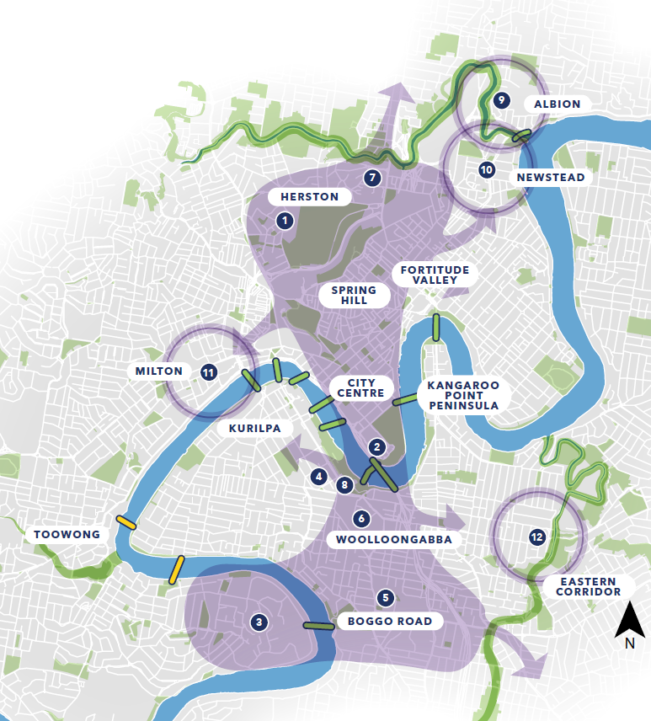
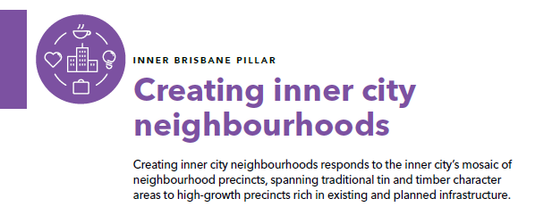
Future Directions
Unlock housing supply through the renewal of key inner city precincts by facilitating increased building heights alongside the delivery of design excellence and community benefit
Renew the inner city’s Urban Enterprise Areas as dynamic and liveable neighbourhoods
Market the unique specialisations of the inner city’s knowledge corridor precincts and Urban Enterprise Areas to attract new business
Transform our inner city laneways and underused spaces into engaging places
Explore innovative housing supply and management models, including build-to-rent and student accommodation.
Review universal housing and accommodation design standards and incentives to increase supply across the inner city

Slide 16

Precinct planning is our pathway to success
Precinct planning underpins delivery of the Strategy’s initiatives and directions
In the lead up to the Brisbane 2032 Olympic and Paralympic Games and beyond, Council will progressively undertake precinct planning for priority precincts
Initial focus will be on precincts which feature major venues for the Brisbane 2032 Games and precincts that are rich in infrastructure and well located to accommodate sustainable growth

Slide 17
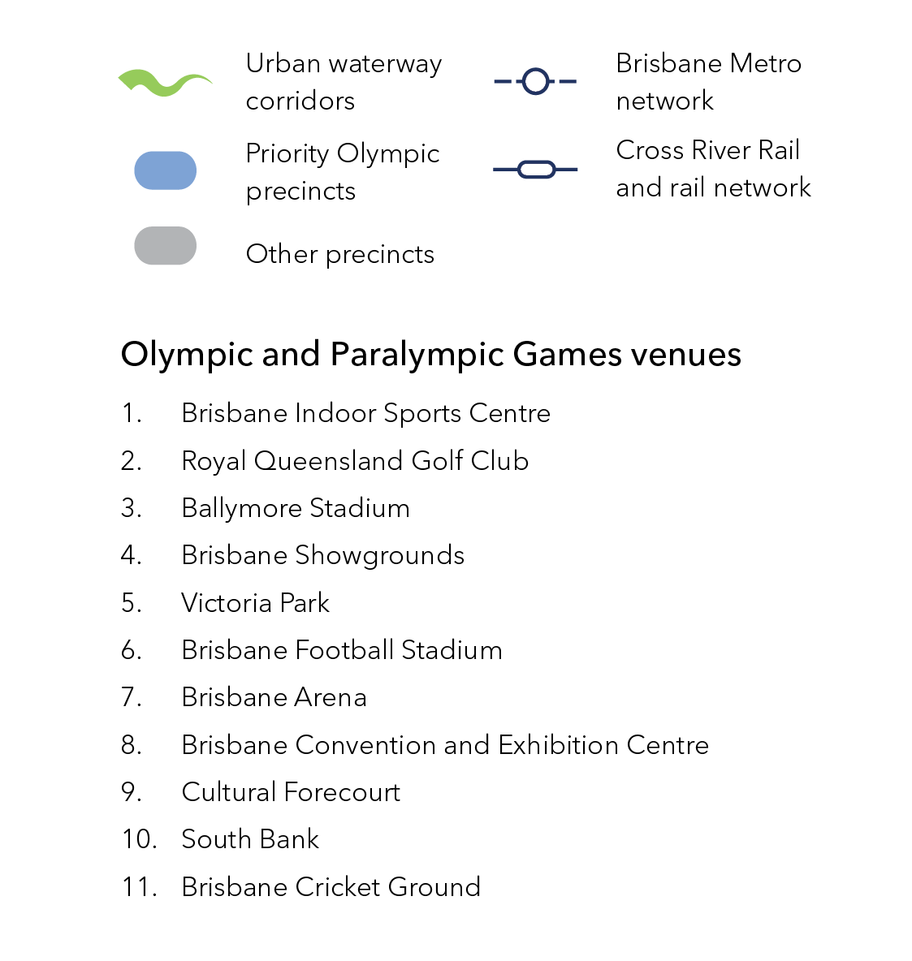
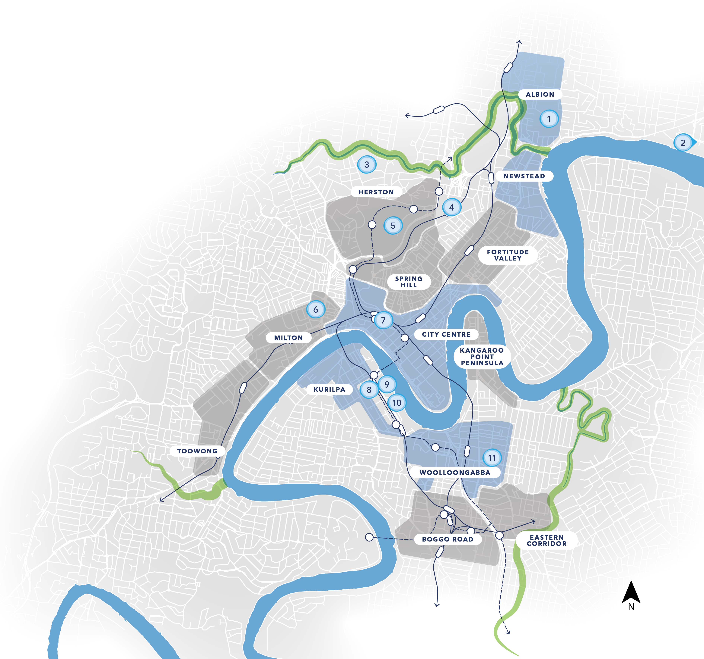
Priority sustainable
growth precincts
Kurilpa
City Centre
Albion
Newstead
Woolloongabba

Slide 18
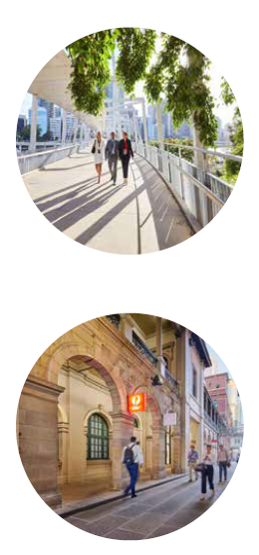
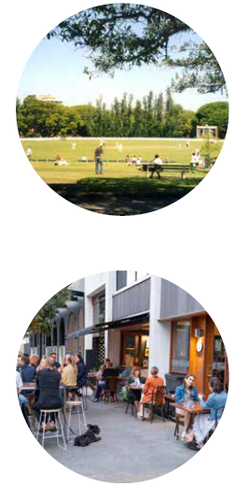
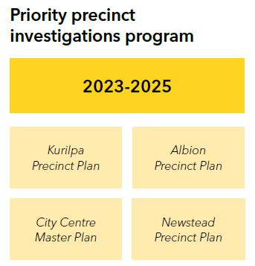
Next Steps
Brisbane’s Inner City Strategy establishes the strategic directions that will shape the future of Brisbane’s inner city sustainable growth precincts and guide Council’s forward program of precinct planning.
Kurilpa
Precinct Plan
Albion Precinct Plan
City Centre
Master Plan
Newstead
Precinct Plan

Slide 19
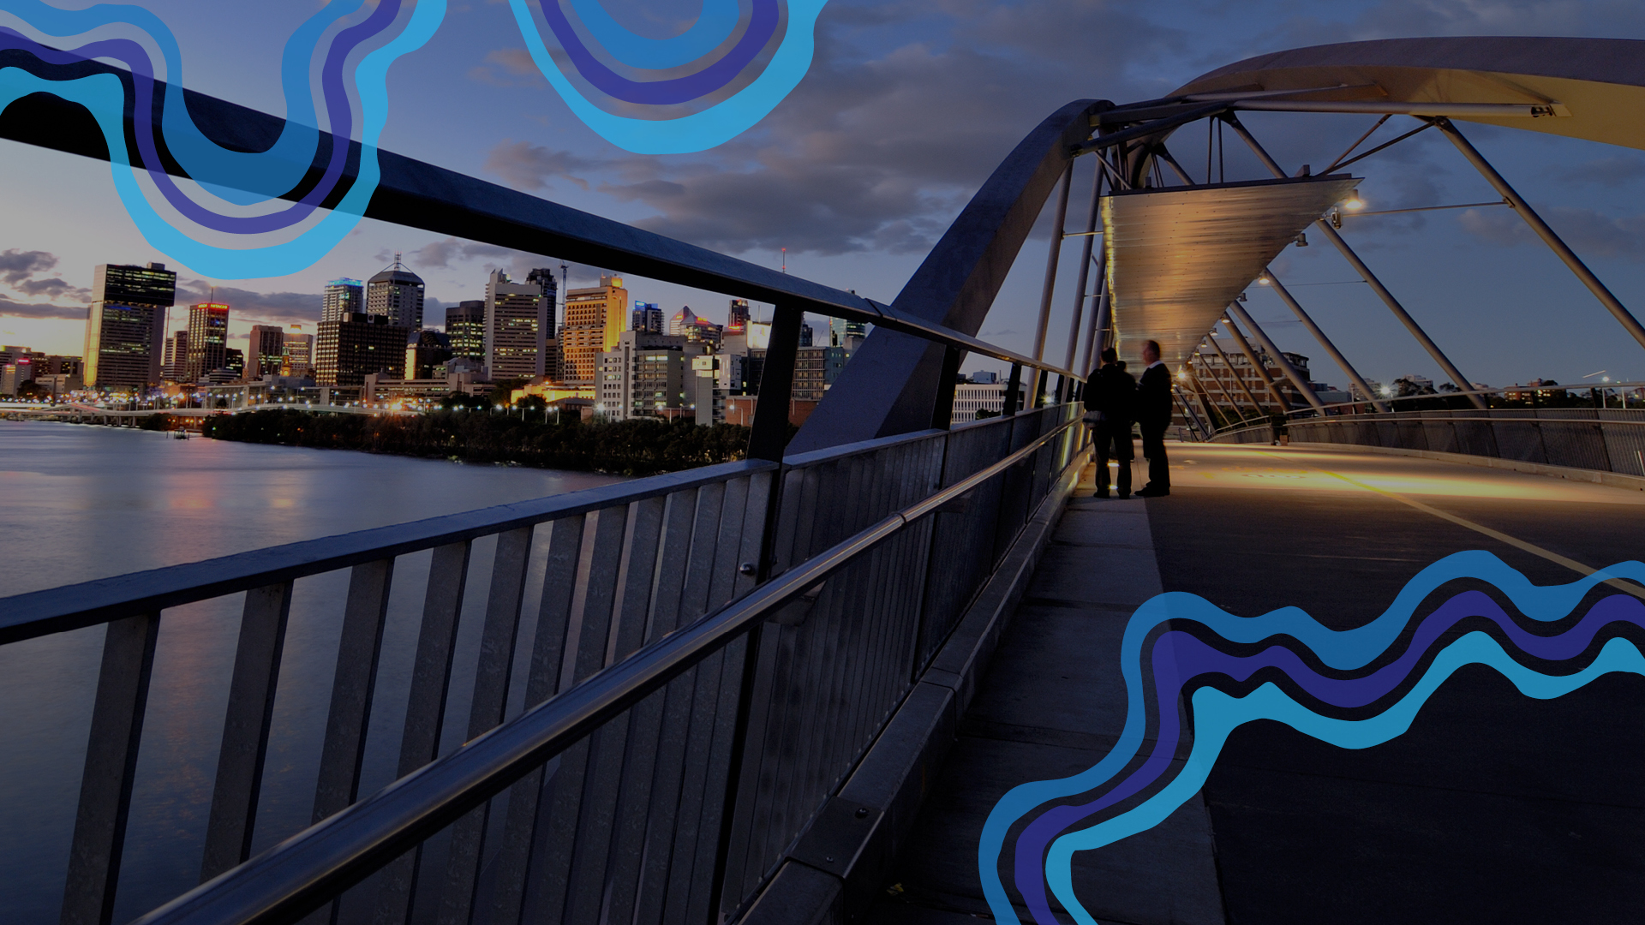

QUESTIONS?

